Slide 1
Hidden Markov Models
Date
08/31/20118
Presented By-
Abhidhar Joshi
Data Scientist (BE, MS)

Slide 2
Contents
Hidden Markov Models - Introduction
Markov Chain, Property and Model
Types of Markov Models
Hidden Markov Model vs Simpler Markov Models
Example – Weather HMM
Learning and Mathematical Description
Three basic problems and Applications

Slide 3
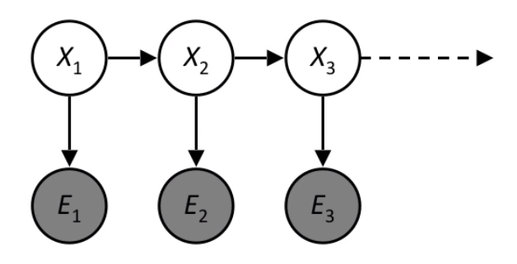
Introduction
Relatively simple way to model sequential Data
Implies that the Markov Model underlying has hidden or unknown data
Only know the observational data
Use knowledge of Markov Models to make educated guess about model

Slide 4
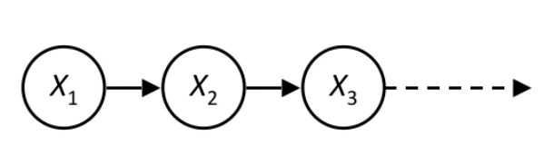
Markov Chain, Property and Model
Markov chain?
Stochastic model describing a sequence of possible events
Markov Property?
Refers to the memoryless property of a stochastic process
Markov Model?
Stochastic model to model randomly changing systems

Slide 5
Types of Markov Models
 | System is fully observable | System state is partially observable
System is autonomous | Markov Chain | Hidden Markov Model
System is controlled | Markov Decision Process | Partially observable Markov Decision Process
Markov Chain
Simplest Markov Model
Hidden Markov Model
Markov chain with partially observable state
Markov Decision Process
Markov chain with state transitions depend on current state action vector
Partially Observable Markov Decision Process
Markov decision process with state of system is only partially observed

Slide 6
Hidden Markov Model vs Simpler Markov Models
“Hidden” in Hidden Markov Models
Adjective “hidden” refers to state sequence, not parameters
Still referred to as a “hidden Markov model” even if parameters are known
Hidden vs simpler Markov models?
Simpler Markov models - state is directly visible to the observer v/s
HMM - state is not directly visible, but the output

Slide 7


Example – Weather HMM
Alice and Bob live far apart from each other but talk regularly
Bob is interested in three activities:
Walking in the park, Shopping & Cleaning
Choice determined exclusively by weather
Alice tries to guess what weather must have been like

Slide 8
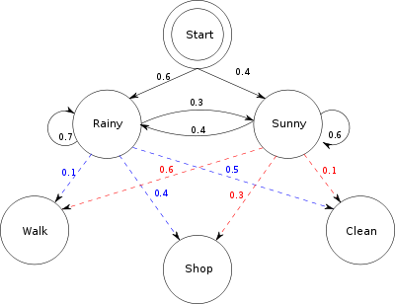
Example – Weather HMM
Alice believes that the weather operates as a discrete Markov chain
Two states, "Rainy" and "Sunny“
Based One of the following activities:
"walk", "shop", or "clean“
Alice knows general weather trends

Slide 9
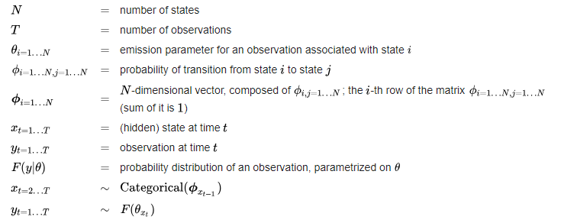
Learning and Mathematical Description
Learning task in HMM
Given an output sequence or set of sequences, best set of state transition and emission probabilities
Mathematical Description

Slide 10
Three basic problems and Applications
Three problems
Evaluation Problem - Find the probability of an observation P(O | λ)
Decoding Problem - Find the most likely state sequence (s1, s2… sn)
Learning or Optimization problem –
Find observation sequence (O1, O2…On)
Hidden Markov Model λ = (A, B, π)
Applications of Hidden Markov Models
Computational finance
Speech recognition
Gene prediction
Handwriting recognition
Time series analysis

Slide 11
Thank you

